Slide 1
CarSharing
Design Document
SE project, Artemiy Frolov

Slide 2
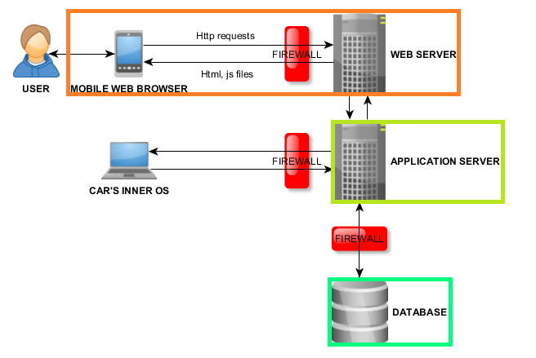
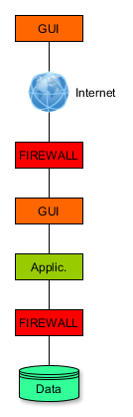
High-level architecture

Slide 3
High-level components

Slide 4
Component view

Slide 5
Architectural styles and patterns
Patterns:
Client-server architecture
Model-View-Controller (MVC)
Protocols:
Java Data Objects (JDO): between BLL and DAL
RESTful API: between client and server

Slide 6
Requirements traceability
All system’s services go through RequestController:
[G1] Registered users(users) can access the system
RegistrationController
LogInController
[G2] Users can locate all unoccupied electric cars parked nearby or within a specific area
ReservationController
LocationController
CarController

Slide 7
Requirements traceability (continue)
[G3] Users can see the information about battery fulness of each unoccupied electrical car.
ReservationController
LocationController
CarController
[G4] Users can reserve available electric car.
ReservationController

Slide 8
Requirements traceability (continue 2)
[G5] Users can access the reserved car
ReservationController
LocationController
CarController
[G6] Users can park the car for later usage without missing the "occupied" status.
ReservationController
LocationController
CarController

Slide 9
Requirements traceability (continue 3)
[G6] Users can park the car for later usage without missing the "occupied" status.
ReservationController
LocationController
CarController
[G7] Users are notified about current driving charges.
ReservationController
PaymentCalculator
CarController

Slide 10
Requirements traceability (continue 4)
[G8.1] Users have a 10% discount when he picks at least 2 more passenger onto the car.
[G8.2] Users have a 20% discount on the ride if he left the car with no more than 50%.
ReservationController
PaymentCalculator
CarController
+ algorithm is described in the paragraph "Algorithm design"

Slide 11
Questions?

